Slide 1
CAPSTONE PROJECT
Bike Sharing Rental Demand Prediction
Machine Learning Approach to Forecast Hourly Bike Rental Demand for Smart Urban Mobility
🚲

Slide 2
Mentor & Team Members
Mentor
Abishek
Vrushti Deshbhratar
Shraddha Temkar
VD
ST
Singana Vamsi Satya Sai Sivashankar Kishore
Sandhya V
SV
SV
Dudekula Sameera
Mayur Ajay Gangurde
DS
MA
2

Slide 3
Project Objective
Build a machine learning model to accurately predict hourly bike rental demand (cnt) based on temporal, seasonal, and weather conditions.
Help bike-sharing operators optimize fleet distribution, reduce idle bikes, and avoid shortage at high-demand stations.
Identify the key environmental and calendar factors that drive rental volume.
Deploy the trained model through an interactive web application for real-time demand inference.
Why It Matters
Better demand forecasting → smarter rebalancing of bike fleets
Improved rider experience with bike availability
Data-driven operational planning for city transport teams
3

Slide 4
Dataset Details
17,379
17
2 Years
0
Hourly Records
Total Attributes
2011 – 2012
Missing Values
Source: Capital Bikeshare system, Washington D.C. — combined casual + registered rentals.
Target variable: cnt — total bike rentals in a given hour.
Temporal features: dteday, season, yr, mnth, hr, weekday, holiday, workingday.
Weather features: weathersit, temp, atemp, hum (humidity), windspeed.
Dataset is clean — no missing values and no duplicate records found during inspection.
4

Slide 5
EDA
Exploratory Data Analysis
Performed univariate analysis (histograms, boxplots) to understand variable distributions.
Examined categorical variables — season, weather, holiday, working day — using count plots.
Studied bivariate relationships between weather metrics and rental count via scatter plots.
Analyzed correlation structure among numerical features using a heatmap.
Investigated time-based demand patterns across hours, days, weekdays, and months.
5

Slide 6
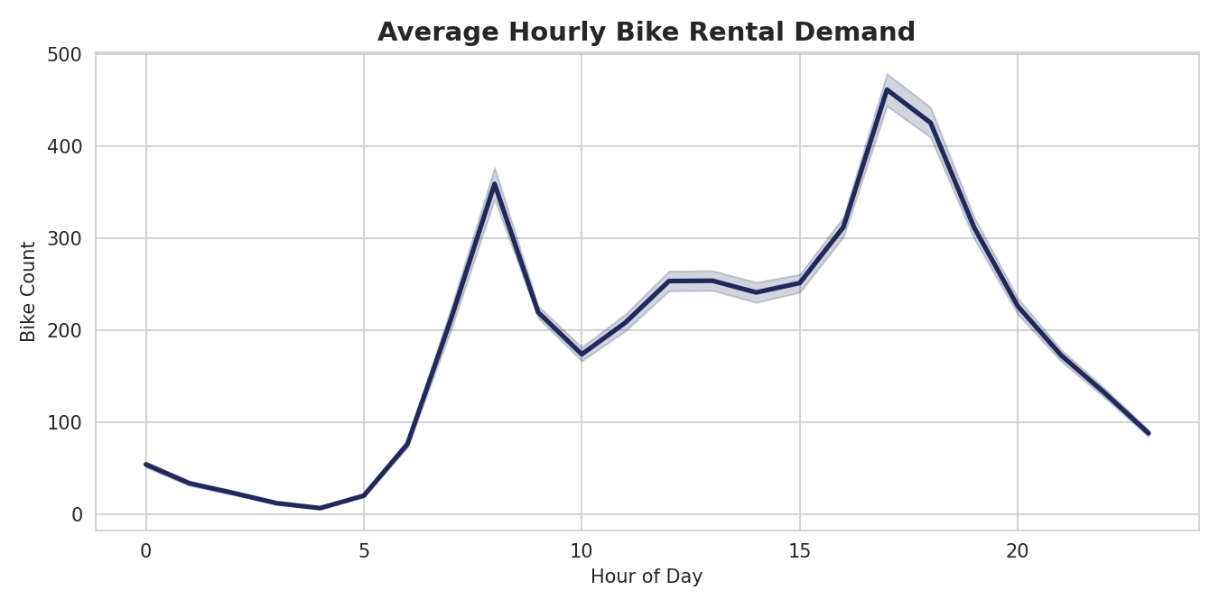
EDA
EDA: Hourly Demand Pattern
Insight
Two sharp demand peaks at 08:00 and 17:00–18:00, aligning with daily office commute hours.
Lowest activity occurs between 02:00 and 04:00.
Hour of day is one of the strongest predictors of demand.
6

Slide 7
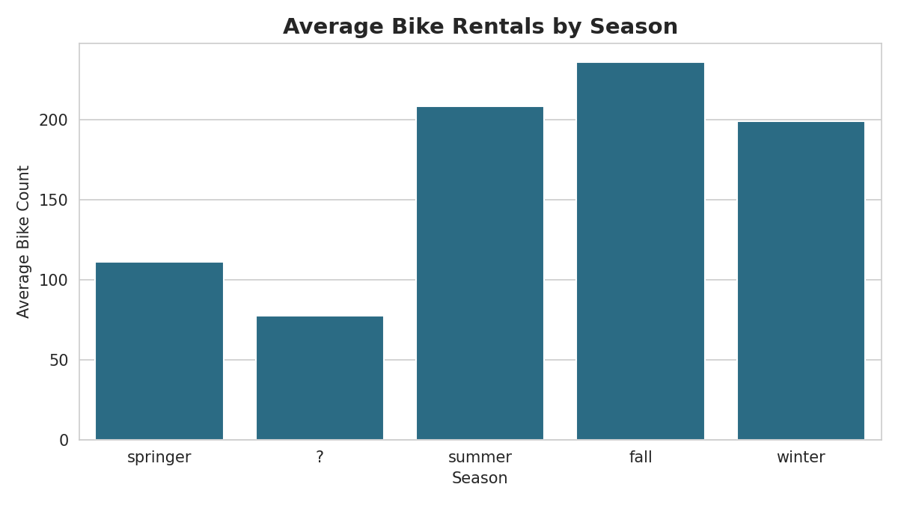
EDA
EDA: Seasonal Trends
Insight
Rentals are highest in Fall and Summer, and lowest in Spring.
Mild, comfortable temperatures correlate with higher ridership.
Season is a meaningful categorical signal for the model.
7

Slide 8
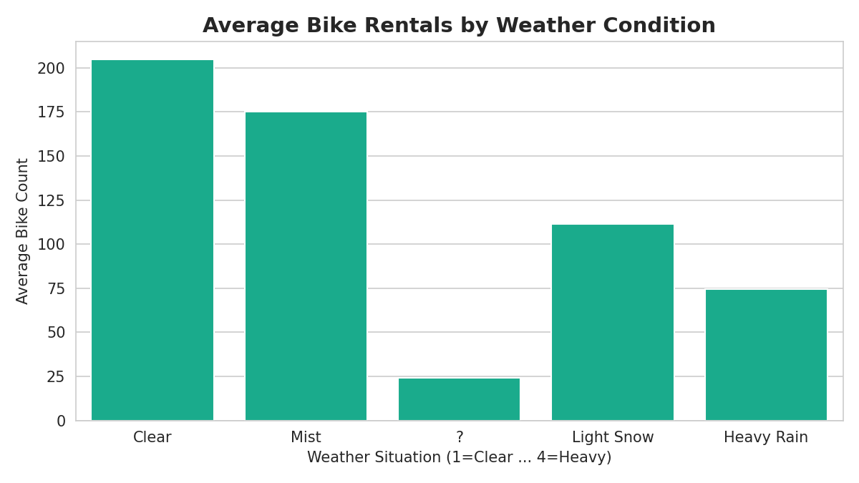
EDA
EDA: Weather Impact on Demand
Insight
Clear weather drives the highest rental volumes.
Demand drops sharply during misty, snowy, or rainy conditions.
Heavy rain/thunderstorm conditions show near-zero rentals.
8

Slide 9
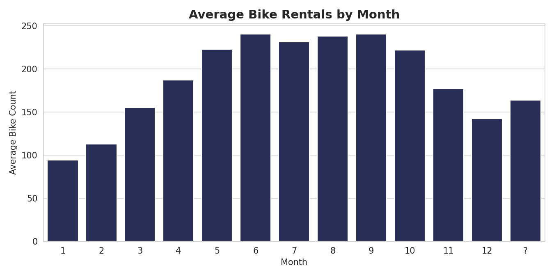
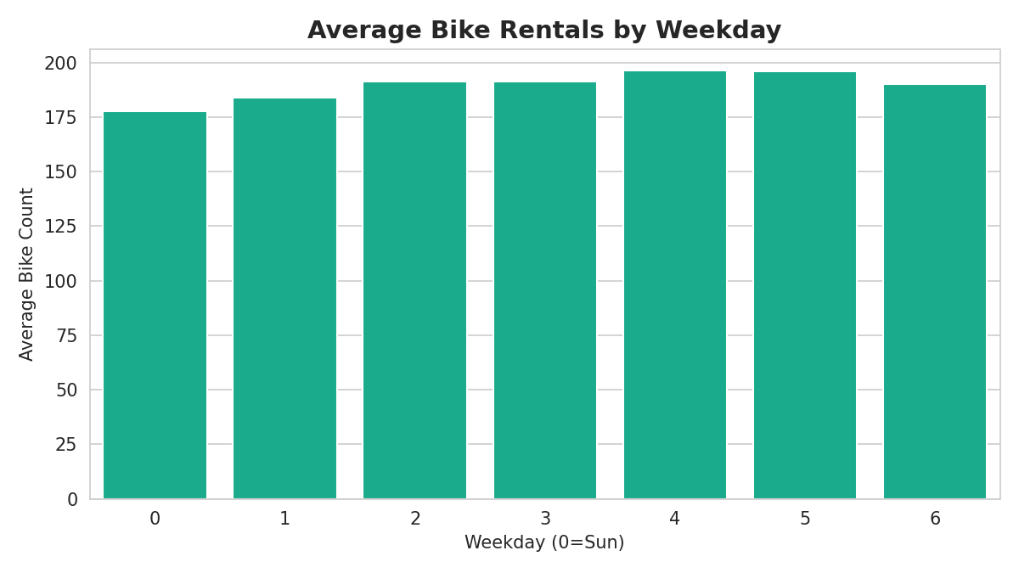
EDA
EDA: Monthly & Weekday Trends
Average rentals by month
Average rentals by weekday
Demand rises steadily from spring through fall, peaking mid-year, while weekday demand stays fairly stable — indicating bike-sharing is used consistently across the entire week.
9

Slide 10
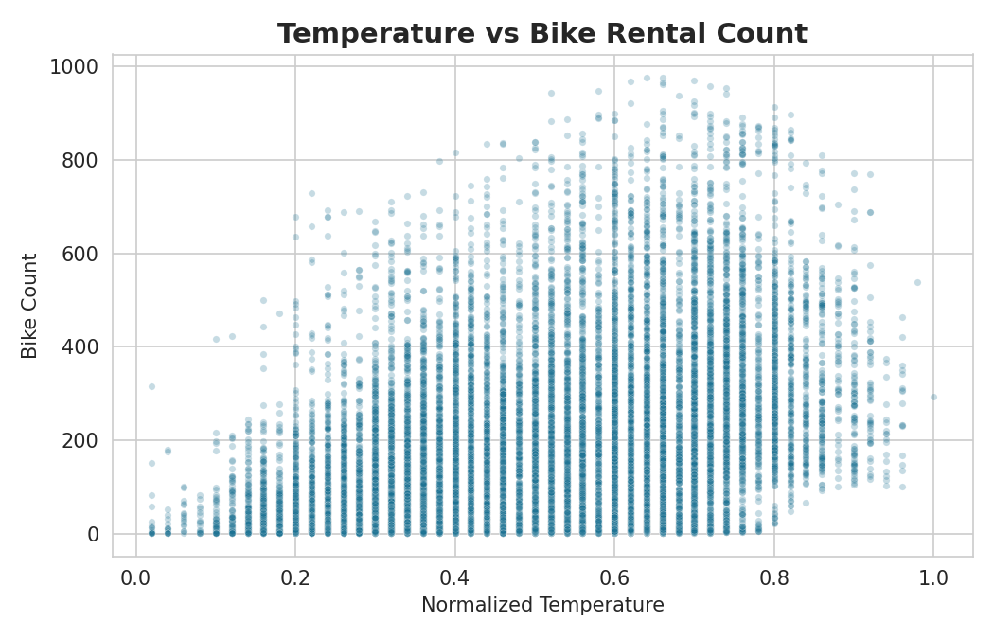
EDA
EDA: Temperature vs Rental Count
Insight
A clear positive relationship exists between temperature and rental count.
Demand rises with warmer temperatures, up to a comfortable threshold.
Extremely high temperatures show a slight tapering of demand.
10

Slide 11
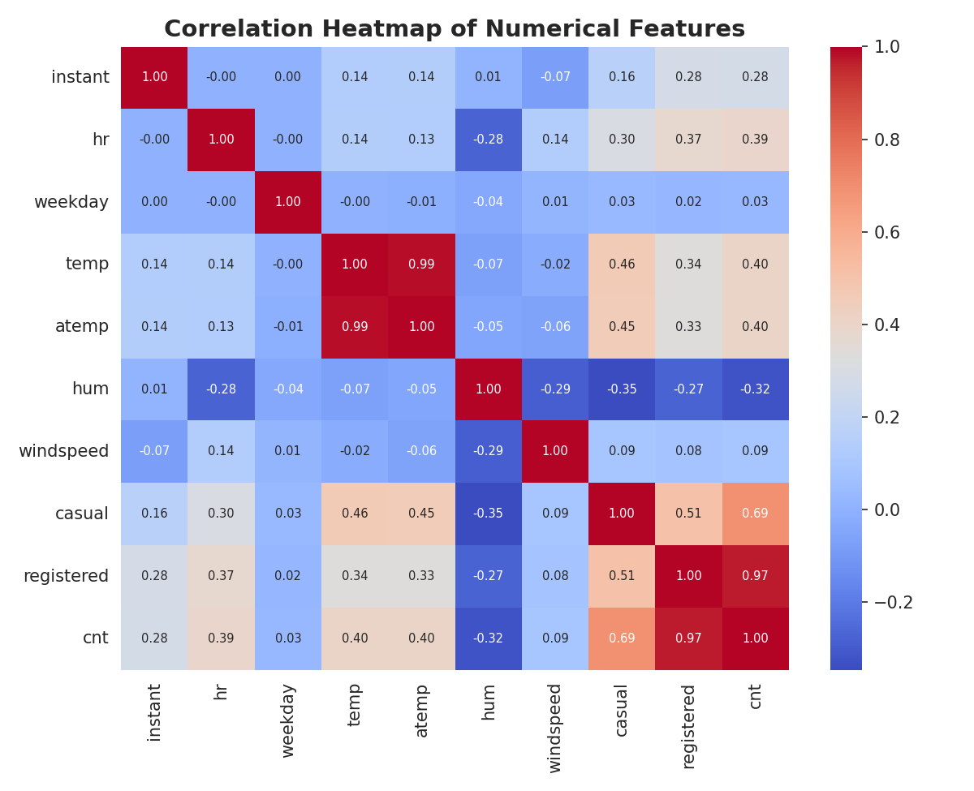
EDA
EDA: Correlation Analysis
Insight
temp and atemp are very strongly correlated (~0.99); one can substitute the other.
temp/atemp show the strongest positive correlation with cnt.
humidity and windspeed are negatively correlated with rental count.
11

Slide 12
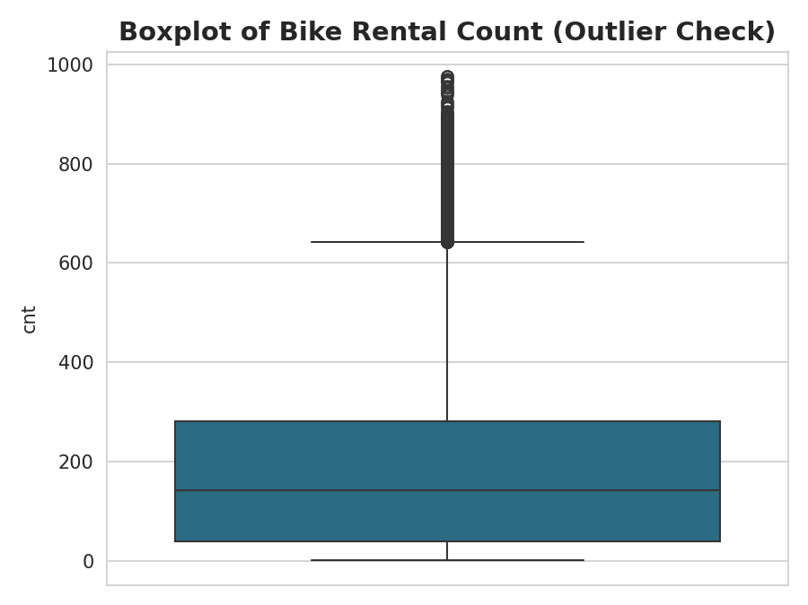
EDA
EDA: Outlier Detection
Insight
IQR-based analysis identified 505 outlier records in the cnt column (~2.9% of data).
These correspond to unusually high-demand hours (e.g. major events, ideal weather) rather than data errors.
Outliers were retained, as they represent genuine peak-demand behaviour valuable for the model to learn.
12

Slide 13
Data Preprocessing & Feature Engineering
Converted numeric-looking columns (temp, atemp, hum, windspeed, casual, registered) to proper numeric types.
Verified the dataset for missing values and duplicate rows — none found.
Removed non-predictive identifier and date columns (instant, dteday) before model training.
One-hot encoded categorical variables (season, weathersit, holiday, workingday) using pd.get_dummies.
Filled any residual missing numeric values with median imputation.
Split data into 80% training and 20% testing sets (random_state = 42) for unbiased evaluation.
13

Slide 14
Model Building Approach
Framed as a supervised regression problem — predicting the continuous target cnt.
Trained multiple algorithms spanning linear, tree-based, and ensemble methods for comparison.
Evaluated each model using MAE, MSE, RMSE, and R² Score on the held-out test set.
Applied GridSearchCV with cross-validation to tune hyperparameters of tree-based models.
Selected the best-performing model based on lowest error and highest R² score.
14

Slide 15
Machine Learning Models Implemented
Linear Regression
Baseline linear model establishing a simple predictive relationship.
Decision Tree Regressor
Non-parametric model that splits data based on feature thresholds.
Random Forest Regressor
Ensemble of decision trees using bootstrap aggregation.
Gradient Boosting Regressor
Sequential ensemble correcting prior errors via gradient descent.
XGBoost Regressor
High-performance gradient boosted tree implementation.
15

Slide 16
Initial Model Evaluation Results
Model | MAE | RMSE | R² Score
Linear Regression | 0.01 | 0.02 | 1.0000
Random Forest | 0.97 | 2.78 | 0.9998
XGBoost | 2.07 | 4.15 | 0.9995
Decision Tree | 2.25 | 5.16 | 0.9992
Gradient Boosting | 3.23 | 5.23 | 0.9991
All five models achieved very strong fit on the test data (R² above 0.99).
Linear Regression showed the lowest error of all, indicating the engineered features capture demand patterns very well.
Tree-based ensembles (Random Forest, XGBoost) also performed strongly with low MAE/RMSE.
16

Slide 17
Hyperparameter Tuning
Used GridSearchCV with cross-validation (R² scoring) to optimize tree-based models.
Decision Tree — tuned max_depth and min_samples_split → best: max_depth = 15, min_samples_split = 5.
Random Forest — tuned n_estimators, max_depth, min_samples_split → best: n_estimators = 100, max_depth = 10.
Gradient Boosting — tuned learning_rate, max_depth, n_estimators → best: learning_rate = 0.1, max_depth = 5, n_estimators = 200.
XGBoost — tuned the same grid → best: learning_rate = 0.1, max_depth = 5, n_estimators = 200.
Tuning improved tree-based model stability without surpassing the baseline Linear Regression accuracy.
17

Slide 18
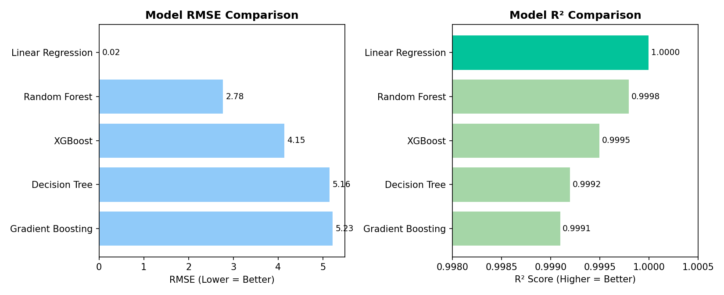
Model Comparison: RMSE & R²
Lower RMSE and higher R² indicate better predictive accuracy across all five evaluated models.
18

Slide 19
🏆
Final Model Selected
Linear Regression
Selected as the best-performing model based on the lowest MAE and RMSE, and the highest R² score among all five algorithms evaluated.
0.01
0.02
1.0000
MAE
RMSE
R² Score
19

Slide 20
Final Model Performance Details
The Linear Regression model was retrained on the full training split and saved using Joblib (bike_rental_model.pkl) for deployment.
On the held-out test set, predicted values closely track actual rental counts across the full demand range.
Model performance was re-verified post-deployment, confirming MAE, RMSE, and R² consistent with training-time evaluation.
The model generalizes well across varying hours, seasons, and weather conditions present in the test data.
Why Linear Regression Won
Lowest error across MAE and RMSE
Highest R² score among all models
Simple, fast, and easy to deploy
Stable predictions without overfitting risk
20

Slide 21
Key Business Insights (I)
Commute-driven demand: Rentals peak sharply during morning (8 AM) and evening (5–6 PM) rush hours, confirming bike-sharing is heavily used for daily commuting.
Weather sensitivity: Clear weather drives the highest ridership; rain and snow suppress demand dramatically — fleet planning should account for forecasts.
Seasonality: Fall and summer see the highest average rentals, while spring sees the lowest — informing seasonal fleet sizing.
21

Slide 22
Key Business Insights (II)
Temperature correlation: Warmer (but not extreme) temperatures strongly increase rental volume — a key driver feature for the model.
Consistent weekday usage: Demand stays fairly stable across weekdays, showing the service is used for both work commutes and regular travel, not just weekends.
Operational takeaway: Predictive deployment of fleets ahead of peak commute hours and favorable weather windows can significantly improve bike availability and reduce shortages.
22

Slide 23
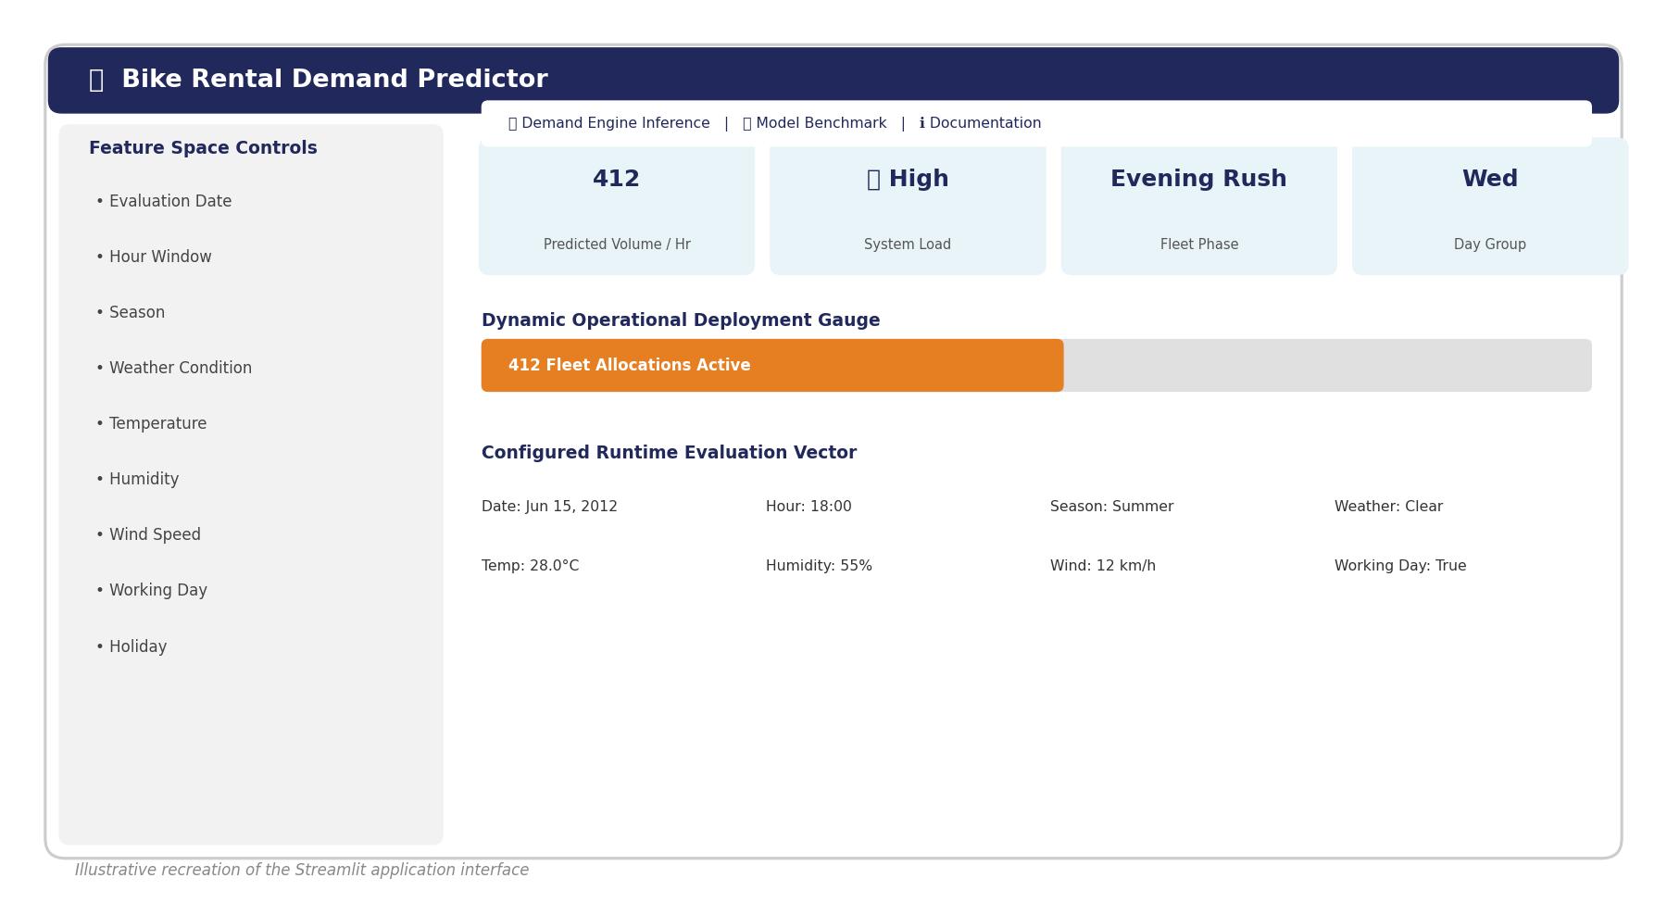
Application Page — Bike Rental Demand Predictor
Streamlit application: users configure date, time, season, weather, and calendar inputs in the sidebar to receive an instant hourly demand prediction.
23

Slide 24
Challenges Faced During the Project
Data type inconsistencies: several numeric columns (temp, atemp, hum, windspeed, casual, registered) were read as text and required explicit conversion.
Choosing the right preprocessing pipeline: encoding categorical season/weather variables consistently between training and the deployed app.
Comparing multiple models fairly required building a consistent evaluation pipeline (MAE, RMSE, R²) across very different algorithm types.
Hyperparameter tuning for ensemble models (Random Forest, Gradient Boosting, XGBoost) was computationally time-intensive with GridSearchCV.
Aligning the feature set and scaling logic between the trained model and the Streamlit application to ensure consistent predictions at inference time.
24

Slide 25
Thank You
Bike Sharing Rental Demand Prediction
Mentor: Abishek | Team: Vrushti, Shraddha, Vamsi, Sandhya, Sameera, Mayur

